Slide 1
Horizon 2020
Information and Communication Technologies
in Work Programme 2016-17
Annalisa BOGLIOLO
DG CONNECT
European Commission

Slide 2
A few reminders on Horizon 2020…
Biggest EU R&I programme ever
  €77 billion of EU funding over 2014-2020
  ~ 27% increase compared to 2007-2013
Core part of Europe 2020's strategy
  Smart, sustainable and inclusive growth
  Main objectives
  Responding to the economic crisis to invest in future jobs and growth
  Addressing people’s concerns about their livelihoods, safety and environment
  Strengthening the EU’s global position in research, innovation and technology
2

Slide 3
A few reminders on Horizon 2020…
  A single programme bringing together three separate programmes/initiatives*
  Coupling research to innovation – from research to retail,
  all forms of innovation
  Focus on societal challenges facing EU society, e.g. health,
  clean energy and transport
  Simplified access, for all companies, universities, institutes in
  all EU countries and beyond
* The 7th Research Framework Programme (FP7), innovation aspects of Competitiveness and Innovation Framework Programme (CIP), EU contribution to the European Institute of Innovation and Technology (EIT)
3

Slide 4
Three priorities
Excellent science
Industrial leadership
Societal challenges

Slide 5
Coverage of the full innovation chain
Societal challenges
Industrial leadership
Excellent science
Basic
Research
Demonstration
Large scale
validation
Market
uptake
Technology
R&D
Prototyping
Pilots

Slide 6

Lessons learned from 2014-15 calls…
…Changes for 2016-17
Increased support to cross-cutting activities
    Focus areas
Consolidation and strengthening of the SME instrument
    Single call grouping all topics across the WP
    Fewer and broader topics, with higher budget per topic and overall
Change of innovative procurement instruments (PCP/PPI)
    Move from co-fund to standard grants
    Increase of funding rates (90%/35%)
  Reinforcement of international cooperation
  Increased use of inducement prizes
  More precision, focus and clarity in the topic descriptions (notably the expected impacts)…while keeping up an open and
  non-prescriptive approach
6

Slide 7

ICT in Horizon 2020

Slide 8
Reminder: ICT in H2020 > LEIT-ICT
Excellent Science
Frontier Research (ERC)
Future and Emerging Technologies (FET)
Skills and career development (Marie Skłodowska-Curie)
Research Infrastructures
ICT
ICT
Industrial Leadership
Leadership in enabling
and industrial technologies
ICT
Nanotech., Materials, Manuf. & Processing
Biotechnology
Space
Access to risk finance
Innovation in SMEs
Societal Challenges
Health, demographic change and wellbeing
Food security, sustainable agriculture,
and the bio-based economy
Secure, clean and efficient energy
Smart, green and integrated transport
Climate action, resource efficiency,
and raw materials
Inclusive, innovative and reflective societies
Secure societies
ICT
ICT
ICT
ICT
ICT
ICT
ICT
ICT
ICT
ICT
8

Slide 9
Public Private Partnerships in ICT
Joint Technology Initiative
ECSEL (Electronic Components and Systems for European Leadership)
  1,215 b€ from EU
  3,6 b€ (out of which 1,2 b€ from Member States) from industry partners and other sources
Contractual PPPs
5G –> 700m€ indicatively earmarked in H2020
Photonics –> 700m€
Robotics –> 700m€
High Performance Computing –> 700m€
Factories of the Future (ICT part) –> 450m€
Green Vehicles (ICT part) –> 80m€
Big Data -> 500m€
Cybersecurity -> 450 m€
9

Slide 10
ICT in Excellent science
Excellent science
Industrial leadership
Societal challenges
10

Slide 11

Excellent Science - ICT
Future and Emerging Technologies (FET)
    FET Open: fostering novel ideas
    FET Proactive: nurturing emerging themes and communities
    FET Flagships: pursuing grand interdisciplinary science and technology challenges
        Graphene
        Human Brain Project
Research infrastructures
    Developing the European research infrastructure for 2020 and beyond
      Development, deployment and operation of ICT-based e-infrastructures
        ICT infrastructure resources and services for Research
        Access to and management of scientific data
        High Performance Computing
11

Slide 12

Future and Emerging Technologies
2017
FET Open (114 M€)
    Still open to all radically new technologies in all areas
    Introduction of FET Innovation Launchpad
      stimulate innovation by initiating entrepreneurial activities around results from FET research projects
FET Proactive
    Boosting emerging technologies
      Introduction of FET ERA-Net cofund actions
    High Performance Computing (44 M€)
      Part of HPC PPP / complementary to eInfra and LEIT-ICT activities
  FET Flagships (166 M€)
    Continuation of Graphene and Human Brain Project flagships
12

Slide 13

Research Infrastructures
2017
eInfrastructures (86 M€)
    Support the European policies on open research data, data and computing intensive science, research and education networking, high-performance computing and big data innovation.
      Integration and consolidation of e-infrastructure platforms
      Prototyping innovative e-infrastructure platforms and services for research and education communities, industry and the citizens at large
  Interactive Computing e-infrastructure for the Human Brain Project FET Flagship (25 M€)
13

Slide 14
ICT in Industrial leadership
Excellent science
Industrial leadership
Societal challenges
14

Slide 15
Approach to WP2016-17
Consolidate the innovation drive initiated in 2014-15
    Supporting core ICT industries through roadmap-based PPPs
      New cPPP: Big Data
    Facilitating disruptive innovation
      Strengthening of ODI
      Continuation of 'Fast Track to Innovation' pilot
    Introducing new cross-cutting actions and reinforcing large scale piloting in real world environments
      IoT and Digital Security focus areas
      IoT and Big Data large scale pilots
Ensure the supply of future technological building blocks
    Room for more exploratory research activities within each area
    Reinforce the international dimension of LEIT-ICT
    Coordinated calls with Brazil, Japan and South Korea
15

Slide 16


Industrial Leadership - ICT
A new generation of components and systems:
    engineering of advanced embedded and resource efficient components and systems
Next generation computing:
    advanced and secure computing systems and technologies, including cloud computing
Future Internet:
    software, hardware, infrastructures, technologies and services
Content technologies and information management:
    ICT for digital content, cultural and creative industries
Advanced interfaces and robots:
    robotics and smart spaces
Micro- and nanoelectronics and photonics:
    key enabling technologies
16

Slide 17

Components and systems
2016-2017
85 M€
Cover systemic integration from smart integrated components to cyber-physical systems
Complementary to the JTI Electronic Components and Systems (ECSEL)
Organised in four topics:
    Smart cyber-physical systems
      Next generation embedded and connected systems
    Thin, Organic and Large Area Electronics
    Smart system integration
      Integration of heterogeneous micro- and nanotechnologies into smart systems
    Smart Anything Everywhere initiative
17

Slide 18

Advanced Computing and Cloud Computing
2016-2017
77 M€
Reinforce and expand Europe's industrial and technology strengths in low-power ICT
Foster the evolution of Cloud technology to increase its uptake
Complementary to the work in the Excellent Science pillar under Research Infrastructures and FET (on High Performance Computing)
Organised in two topics:
    Customised and low energy computing (32 M€)
    Cloud Computing
18

Slide 19

Future Internet
2016-2017
255 M€
Integrated response to technology challenges and innovation needs of the future Internet
Organised in seven topics:
    5G PPP Research and Validation of critical technologies and systems
    5G PPP Convergent Technologies
    Networking research beyond 5G
    Software Technologies
    Future Internet Experimentation - Building a European experimental Infrastructure
    Collective Awareness Platforms for Sustainability and Social Innovation (10 M€)
    Net Innovation Initiative
    5G PPP
19

Slide 20

Content technologies
2016-2017
280 M€
Improve access, creation, management and use of data and content through advances along the data, content and knowledge value chains.
Organised in eleven topics (+ one prize):
    Big data PPP
      Cross-sectorial and cross-lingual data integration and experimentation (27 M€)
      Large scale pilots in sectors best benefitting from data-driven innovation (25 M€)
      Research addressing main technology challenges of the data economy (33 M€)
      Support, industrial skills, benchmarking and evaluation (2 M€)
      Privacy-preserving big data technologies
      Big Data inducement prize (2 M€)
    Media and content convergence
    Tools for smart digital content in the creative industries (17 M€)
    Support technology transfer to the creative industries
    Technologies for Learning and Skills
    Interfaces for accessibility (14 M€)
    Gaming and gamification
20

Slide 21
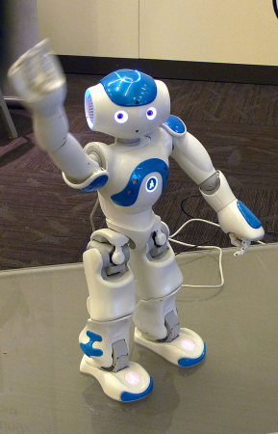
Robotics and autonomous systems
2016-2017
166 M€
Technology-driven actions to keep EU at the cutting edge of research + market-driven actions to accelerate take-up and deployment of robots
Roadmap-based approach
 Robotics PPP
Organised in four topics in LEIT-ICT + one topic in SC2:
    Advanced robot capabilities research and take-up
    (34 M€)
    System abilities, development and pilot installations
    System abilities, SME & benchmarking actions, safety certification (48 M€)
    Robotics competition, coordination and support (5 M€)
    Robotics Advances for Precision Farming (7 M€) (SC2)
21

Slide 22
ICT key enabling technologies
2016-2017
178 M€
Translate Europe's S&T excellence in photonics and micro- and nano-electronics into strengthened competitiveness and market leadership
Address the whole research and innovation value chain in photonics technology: from materials to manufacturing, products and services, through equipment and devices – from advanced R&D to pilot lines
 Photonics PPP (89 M€)
 Complemented by activities of LEIT-NMBP and FoF PPP
Cover generic technology developments on micro- and nano-electronics focused on exploratory research and lower Technology Readiness Levels (TRLs) (23 M€)
    Complementary to the JTI Electronic Components and Systems
  Organised in three topics in LEIT-ICT + one in LEIT-NMBP
  + one in FoF
22

Slide 23
ICT for the Factories of the Future
2016-2017
116 M€
Part of the 'Industry 2020 in the Circular Economy' cross-cutting focus area
Focus on ICT components of innovative production systems in all sectors (for a more personalised, diversified and mass-produced product portfolio and for rapid and flexible reaction to market changes)
Implementation of the FoF PPP
Organised in three topics:
    Digital automation
    ICT Innovation for Manufacturing SMEs (I4MS)
    Photonics laser-based production
23

Slide 24

Internet of Things
2016-2017
139 M€
Cross-cutting focus area
    Contributions from SC1 and SC2
Increased support with the ambition
to foster the take-up of IoT in Europe and
to enable the emergence of IoT ecosystems
supported by open technologies and platforms
Organised in three topics:
    Large scale pilots
      Smart living environment for ageing well
      Smart farming and food security
      Wearables for smart ecosystems
      Reference zones in EU cities
      Autonomous vehicles in a connected environment
    IoT Horizontal activities
    R&I on IoT integration and platforms (35 M€)
24

Slide 25


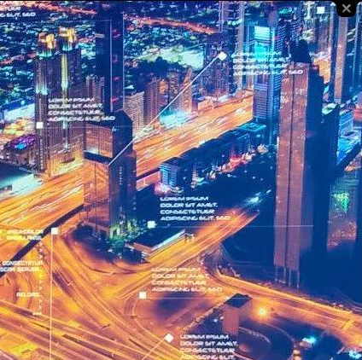

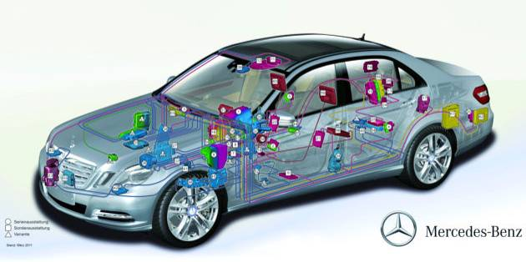
Internet of Things Focus Area
FA IOT Pilot areas:
Pilot 1: Smart living environments for ageing well (EU contr. up to 20 MEUR)
Pilot 2: Smart Farming and Food Security (EU contr. up to 30 MEUR)
Pilot 3: Wearables for smart ecosystems (EU contr. up to 15MEUR)
Pilot 4: Reference zones in EU cities (EU contr. up to 15MEUR)
Pilot 5: Autonomous vehicles in a connected environment (EU contr. up to 20 MEUR)
Total budget:
100 MEUR (funding rate: 70%)
25

Slide 26
Internet of Things Focus Area in WP2016-17
Fostering the take-up of IoT in Europe and enabling the emergence of IoT ecosystems supported by open technologies and platforms.
Supported IoT Pilots will use the rich portfolio of technologies and tools so far developed and demonstrated in reduced environments and extend them to real-life use case scenarios.
provide coherent implementation / programming in H2020 across different themes (AGRI, Health, City, Home) -- consistency and linkages between Policy and Innovation Projects
26

Slide 27
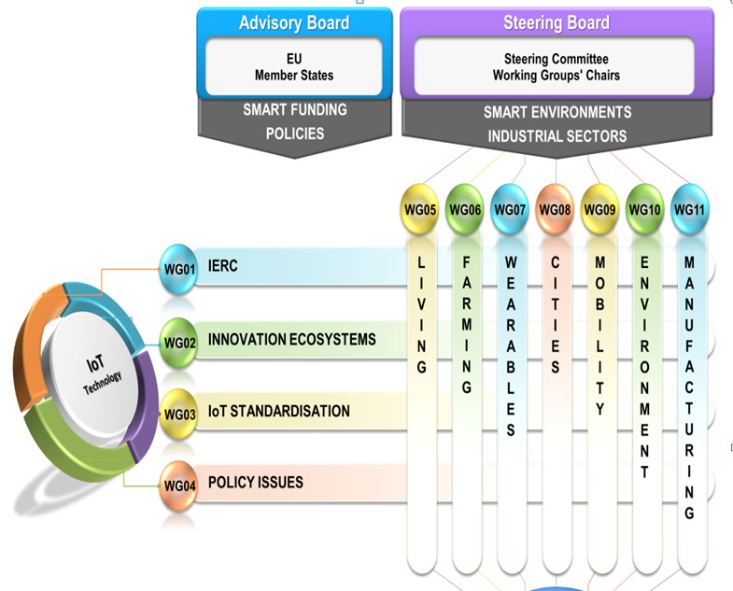
Alliance AIOTI
A cross-sector industrial partnership
Policy cooperation:
AIOTI – Alliance Internet of Things Innovation
Open Platforms that accelerate innovation by companies and communities of developers
Advancing IoT convergence across verticals for standardisation/ interoperability
Discuss with industry to provide
guidance for Digital Single Market
Get connected on www.AIOTI.eu
27

Slide 28
Reflection – Cross cutting Activities Partnerships for leadership on IoT
Open integrated platforms cutting across sectors
    Building on converging technology trends like CPS, Big Data, Cloud, HPC, robotics & autonomous systems, AI
    Extending from IoT to B2B data platforms.
Exploring synergies for platform up-scaling
    Interoperability and standards approaches at technical and semantic levels for object connectivity, protocols, data formats, privacy & security, open APIs;
Focus a significant part of the European and national investments on cross-sectoral and integrated digital platforms and ecosystems incl. reference implementation and experimentation environments in real setting
28

Slide 29

Digital Security
2016-2017
120 M€
Focus area
    Combining contributions from LEIT-ICT, SC1 and SC7
Grouping the main R&D&I activities in digital security, from enabling technologies to specific use cases
Organised in eight topics:
    Cryptography (20,5 M€)
    Assurance and Certification for Trustworthy and Secure ICT systems, services and components
    Addressing Advanced Cyber Security Threats and Threat Actors (18 M€)
    Privacy, Data Protection, Digital Identities (18 M€)
    Cyber Security for SMEs, local public admin. and individuals
    Economics of Cybersecurity
    EU Cooperation and International Dialogues in Cybersecurity and Privacy Research and Innovation
    Increasing digital security of health related data on a systemic level
29

Slide 30
Innovation and Entrepreneurship support
2016-2017
156+ M€
Reinforce the involvement of users in R&D&I
Support digital entrepreneurship
Strengthen the support to start-ups and SMEs
Facilitate the meeting between investors and start-ups
Increase the entrepreneurial skills
Organised in five topics + inducement prizes:
    Startup Europe for growth and Innovation Radar (12 M€)
    Innovation procurement networks (4 M€)
    Pre-commercial procurement open
    Open Disruptive Innovation scheme – SME instrument (66 M€)
    Fast Track to Innovation (100 M€ - for all fields of LEIT and SCs)
    ICT Horizon prizes (10 M€)
30

Slide 31
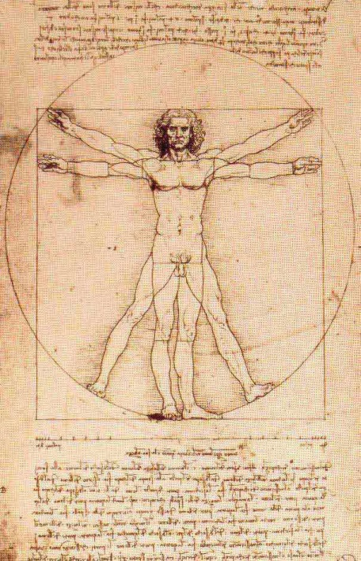
15+ M€
Responsibility and creativity
2016-2017
Cross-cutting activities supporting the nexus between technology, social sciences, humanities and arts.
Foster collaboration with SSH on
responsible research and innovation.
Engage with artists in innovation process to foster
creativity and help enhance user acceptance.
Two dedicated topics:
    Enabling responsible ICT-related research and innovation
    Boost synergies between artists, creative people and technologists
  …Complemented by other activities embedded in technical topics and a large hub supported through SC6.
31

Slide 32






International cooperation
42 M€
International partnership building in low and middle income countries (13 M€) / Target: sub-Saharan Africa and ASEAN
    Coordinated calls
    EU-Brazil (8 M€)
      Cloud computing
      IoT pilots
      5G Networks
    EU-Japan
    EU-South Korea
    Cooperation with Taiwan in 5G PPP topic on Convergent Technologies
  Other international cooperation activities
    China: Collaboration on Future Internet
    Mexico: Collaboration on ICT (with a focus on FIWARE)
32

Slide 33
ICT in Societal challenges
Excellent science
Industrial leadership
Societal challenges
33

Slide 34

Societal Challenges
Health, demographic change and wellbeing
Food security, sustainable agriculture, and forestry, marine, maritime and inland water research,
and the bio-economy
Secure, clean and efficient energy
Smart, green and integrated transport
Climate action, environment, resource efficiency and raw materials
Europe in a changing world – inclusive, innovative and reflective societies
Secure societies – protecting freedom and security of Europe and its citizens
34

Slide 35

Key principles for ICT R&I in the Societal Challenges
Interoperability
Re-use and economies of scale
Breakthroughs leveraging the
transformative power of ICT
Preparation for market deployment
35

Slide 36

Budget
SC | 2014-15 | 2016-17 | 2014-2020 (w/o EFTA) | Total SC (w/o EFTA) | % earmarked for ICT
Health | 268 | 232 | 1 018 | ~ 6 900 | 15%
Food | - | - | - | ~ 3 700
Energy | 72 | TBD | TBD | ~ 5 400
Transport | 85 | TBD | TBD | ~ 5 850
Environment | 25 | TBD | TBD | ~ 2 750
Societies | 78 | 85 | 319 | ~ 1 200 | 26%
Security | 99 | 98 | 384 | ~ 1 550 | 25%
Total | 627 | 415 | 1 903+ | ~ 27 350 | 7%
Note: All budget figures in M€
↓ Different approaches between SCs!
36

Slide 37

Preparation for market deployment
A few examples from WP2016-17
  Big Data
    SC1: Big Data supporting Public Health policies
    SC4: Innovative ICT solutions for future logistics operations
    SC6: Policy-making in the age of Big Data
    SC6: European cultural heritage, access and analysis for a richer interpretation of the past
  Robotics
    SC1: Robotics-based solutions for active and healthy ageing
    SC2: Robot-based precision farming
  Internet of Things
    Smart living environments for ageing well
    Smart farming and food security
    Autonomous vehicles in a connected environment
37

Slide 38

Links to policy initiatives
  eHealth
    eHealth action plan 2012-2020
  Silver Economy
  Digital Single Market
    Privacy & Cybersecurity
    New eGovernment action plan
  Smart Cities and Communities EIP
  Strategic Energy Technology (SET) Plan
  ICT contribution to EU2020 20/20/20 objectives
38

Slide 39

Approach to WP2016-17
Stronger integration of ICT with other disciplines within SC calls
    Joint calls
    Multidisciplinarity
Increased support to activities cutting across SCs and LEIT-ICT
    Focus areas
      Internet of Things
      Digital Security
    Other cross-cutting topics
      Big Data supporting Public Health policies (SC1)
      Policy-making in the age of Big Data (SC6)
Consolidation and strengthening of the SME instrument
39

Slide 40


Health, demographic change and wellbeing
2016-2017
  Continuity with WP2014-15, FP7 and CIP
    Active and healthy ageing
    Personalization of healthcare and patient empowerment
  Contribution to other major WP initiatives in ICT
    Digital Security
    IoT
    Big Data
  Introduction of specific SME-instrument topic
  Innovative public procurement actions
  International cooperation with US and Japan
  Contribution to the AAL programme
40

Slide 41
Health, demographic change and wellbeing
2016-2017
  One single call
    Personalised Medicine
      Understanding health, well-being and disease
      Preventing disease
      Treating and managing diseases
      Active ageing and self-management of health
      Methods and data
      Health care provision and integrated care
      + Coordination activities
41

Slide 42
Health, demographic change and wellbeing
2016-2017
  Personalized Medicine
    Active ageing and self-management of health
      PCP - eHealth innovation in empowering the hospitalised patient
      PPI for deployment and scaling up of ICT solutions for active and healthy ageing
      EU-Japan cooperation on novel ICT Robotics based solutions for active and healthy ageing at home or in care facilities
      Personalised coaching for well-being of older persons (26,5 M€)
    Methods and data
      In-silico trials for developing and assessing biomedical products (19 M€)
      Personalised computer models and in-silico systems for well-being
      (19 M€)
      Big Data supporting Public Health policies
      PPI for uptake of standards for the exchange of digitalised healthcare records (8 M€)
  Coordination activities (2 M€)
42

Slide 43

Food security and sustainable use of natural resources
2016-2017
  Contribution from LEIT-ICT
  to the focus area 'Sustainable Food Security – Resilient and resource-efficient value chains'
    Robot-based precision farming (7 M€)
  Contribution from SC2 to the IoT focus area
    Large-scale pilot on 'Smart farming and food security'
43

Slide 44


Energy
2016-2017
  Continuity with WP2014-15
  …with a stronger emphasis on
    security and affordability of energy from supply to demand
    integration and optimisation of the energy system
  Contribution of ICT
    Energy-efficiency
    Smart distribution grids
    Smart cities and communities
44

Slide 45
Energy
2016-2017
  Three calls (all focus areas)
    Energy-efficiency (194 M€ overall)
      Behavioural change toward energy efficiency through ICT
      Bringing to market more energy efficient and integrated data centres
    Competitive low-carbon energy (725 M€ overall)
      Smart grids, storage and energy system integration technologies
      (2 topics still open – 84 M€)
      Tools and technologies for coordination and integration of the European energy system (30 M€)
    Smart cities and communities (231 M€ overall)
    ↓ part of smart and sustainable cities cross-cutting focus area
      Smart Cities and Communities lighthouse projects (71,5 M€)
45

Slide 46
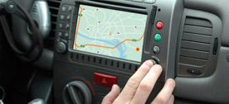

Transport
2016-2017
  Automation of road transport as a priority
  Contribution of ICT
    Automated road transport
    Intelligent Transport Systems
    Logistics
    Green vehicle
46

Slide 47
Transport
2016-2017
  Three calls
    Mobility for growth (436 M€ overall)
      Innovative ICT solutions for future logistics operations
      Intelligent Transport Systems
      Increasing the take up and scale-up of innovative solutions to achieve sustainable mobility in urban areas
    Automated road transport (114 M€ overall)
      ICT infrastructure to enable the transition towards road transport automation
    European green vehicle initiative (206 M€ overall)
      Demonstration (pilots) for integration of electrified L-category vehicles in the urban transport system
47

Slide 48

Climate and environment
2016-2017
  Priority to R&I activities taking a systemic approach
    Circular economy (focus area 'Industry 2020 in the circular economy')
    Climate services
    Nature-based solutions
    Raw materials
  + Other priorities in 2016-17
    Earth observation
    Water
    Cultural heritage
    The Arctic
48

Slide 49
Climate and environment
2016-2017
  One generic SC5 call
  + contributions to three focus areas
    Industry 2020 in the circular economy
    Blue growth
    Smart and sustainable cities
  Opportunities for ICT contributions
    Water management
    Climate and water resilience in cities
    Business models for the circular economy
    European data hub for the GEOSS information system
49

Slide 50

Inclusive, innovative and reflective societies
2016-2017
  Revised WP structure with a better integration of ICT and SSH across three priorities:
    Co-creation for growth and inclusion
    Reversing inequalities and promoting fairness
    Understanding Europe
  Joint SME topic
50

Slide 51
Inclusive, innovative and reflective societies
2016-2017
  Four calls
    Co-creation for growth and inclusion
      Applied co-creation to deliver public services (10 M€)
      Policy-development in the age of Big Data (12 M€)
      Once-only principle
    Reversing inequalities and promoting fairness
      Multi-stakeholder platform for enhancing youth digital opportunities
      Boosting inclusiveness of ICT-enabled research and innovation (3 M€)
    Understanding Europe
      Virtual museums and social platform on European digital heritage,
      memory, identity and cultural interaction
      European cultural heritage, access and analysis for a richer
      interpretation of the past (9 M€)
      Understanding the transformation of European public administrations
      (7 M€)
    Engaging together globally
51

Slide 52

Security
2016-2017
  Integration of physical and cyber-security activities in a joint call on critical infrastructure protection
  Focus area on Digital Security
    with contributions from LEIT-ICT and SC1
  Joint SME topic
52

Slide 53
Security
2016-2017
  Five calls
    Digital Security focus area
    Critical infrastructure protection
    Disaster resilience
    Fight against crime and terrorism
    Border security and external security
53

Slide 54
Security
2016-2017
    Digital Security focus area
      Privacy and Data Protection (18 M€)
      Addressing Advanced Cyber Security Threats and Threat Actors
      (18 M€)
      Cyber Security for SMEs, local public administration and Individuals
      Economics of Cybersecurity
      EU Cooperation and International Dialogues in Cybersecurity and Privacy Research and Innovation
      Increasing digital security of health related data on a systemic level (SC1)
      Assurance and Certification for Trustworthy and Secure ICT systems, services and components (LEIT-ICT)
      Cryptography (LEIT-ICT) (20,5 M€)
    Critical infrastructure protection
      Prevention, detection, response and mitigation of the combination of physical and cyber threats to the critical infrastructure of Europe
      (20 M€)
54

Slide 55

SME Instrument

Slide 56
SME Instrument – ICT
2017
SME Instrument dedicated call (437,5 M€ overall)
    Open Disruptive Innovation Scheme (66 M€)
    Accelerating the uptake of nanotechnologies advanced materials or advanced manufacturing and processing technologies by SMEs (35 M€)
    Accelerating market introduction of ICT solutions for Health, Well-Being and Ageing Well (12,5 M€)
    Stimulating the innovation potential of SMEs for a low carbon and efficient energy system (50 M€)
    Small business innovation research for Transport and Smart Cities Mobility (61 M€)
    New business models for inclusive, innovative and reflective societies (11 M€)
    Engaging SMEs in security research and development (14,5 M€)
56

Slide 57

More information…

Slide 58

Call planning – 2017 (1/2)
FET
FET Open: 17 Jan, 27 Sep 2017
FET Proactive: 24 Jan 2017
FET HPC: 26 Sep 2017
Research Infrastructures: 29 March 2017
LEIT
EU-Brazil: 14 Mar 2017
Main ICT call: 25 April 2017
SC1 (Health):
SC1 call: 31 Jan, 14 Mar 2017
SC2 (Food and agriculture):
Robotics for precision farming: 14 Feb 2017
SC3 (Energy)
Energy-efficiency: 19 Jan, 7 Jun 2017
Competitive Low Carbon Energy: 14 Feb 2017

Slide 59
Call planning – 2017 (2/2)
SC4 (Transport): 26 Jan, 1 Feb 2017
SC6 (Europe in a changing world)
Co-creation: 2 Feb 2017
Reversing inequalities: 2 Feb 2017
Understanding Europe: 2 Feb 2017
SC7 (Security)
Cryptography: 25 April 2017
Other topics (CIP+DS): 24 Aug 2017
Cross-cutting activities
ICT for FoF: 19 Jan 2017
IoT: 25 April 2017
Smart Cities: 14 Feb, 7 Mar 2017
SME instrument
Phase 1: 15 Feb, 3 May, 6 Sep, 8 Nov 2017
Phase 2: 18 Jan, 6 Apr, 1 Jun, 18 Oct 2017

Slide 60
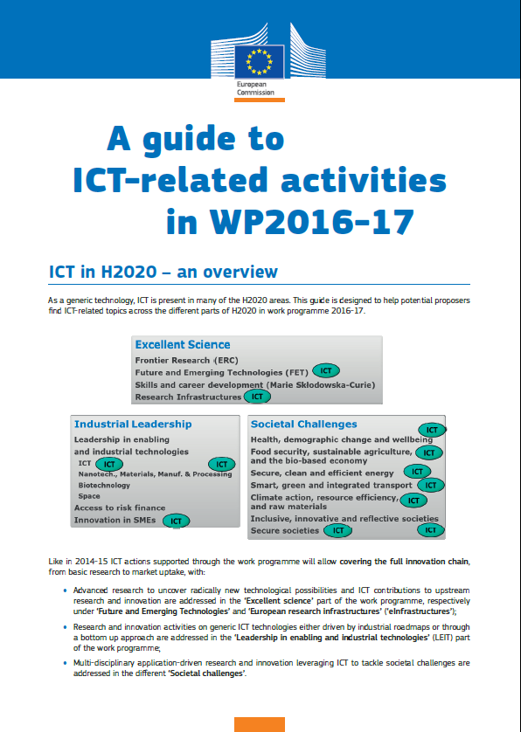
Guide to ICT-related activities in WP2016-17
Comprehensive coverage of the three H2020 pillars
Detailed list of calls and topics
Available on H2020 website

Slide 61

Find out more
Horizon2020 web site
  http://ec.europa.eu/programmes/horizon2020
Participants portal
  http://ec.europa.eu/research/participants/portal
H2020 Helpdesk, including FAQ
  http://ec.europa.eu/research/index.cfm?pg=enquiries
National Contact Points
  http://ec.europa.eu/research/participants/portal/desktop/en/support/national_contact_points.html
61

Slide 62
Thank you for your attention!

